Slide 1
Project Night terror Milestone 1
Evan Geissler
Notes:
**Randomly generate where texts are, items are, placements, etc. Core static, other stuff different.

Slide 2
Project advisor
Dr. chan

Slide 3
Introduction
Milestone 1
Story
Characters
Landscape
Playable Areas
User Interface (HUD)
Main Menu
Credits
Testing

Slide 4
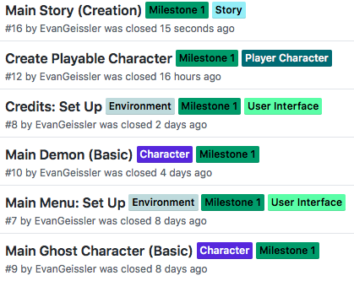
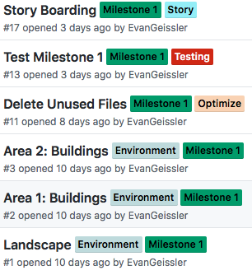
Milestone 1
https://github.com/EvanGeissler/Project-Night-Terror

Slide 5
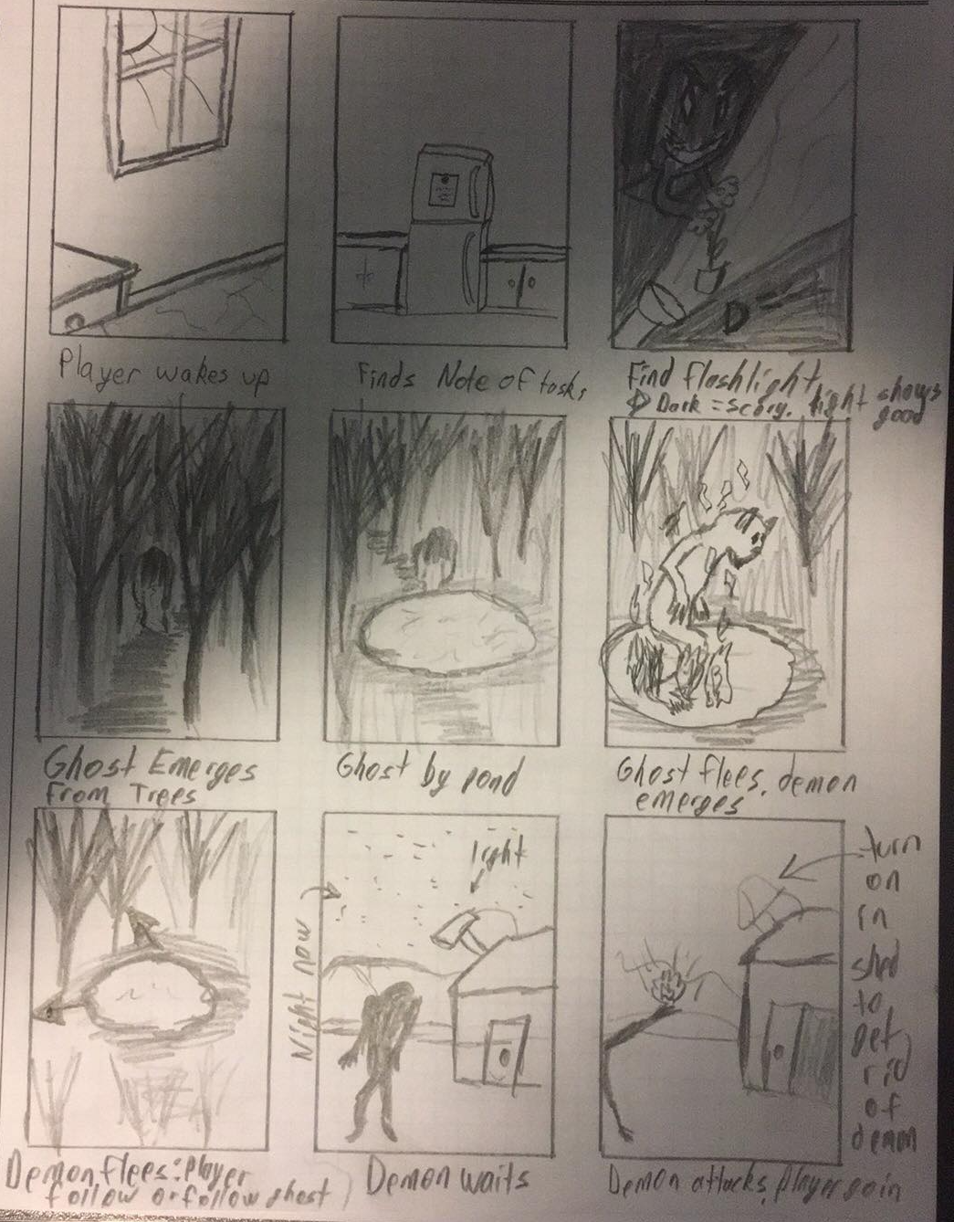
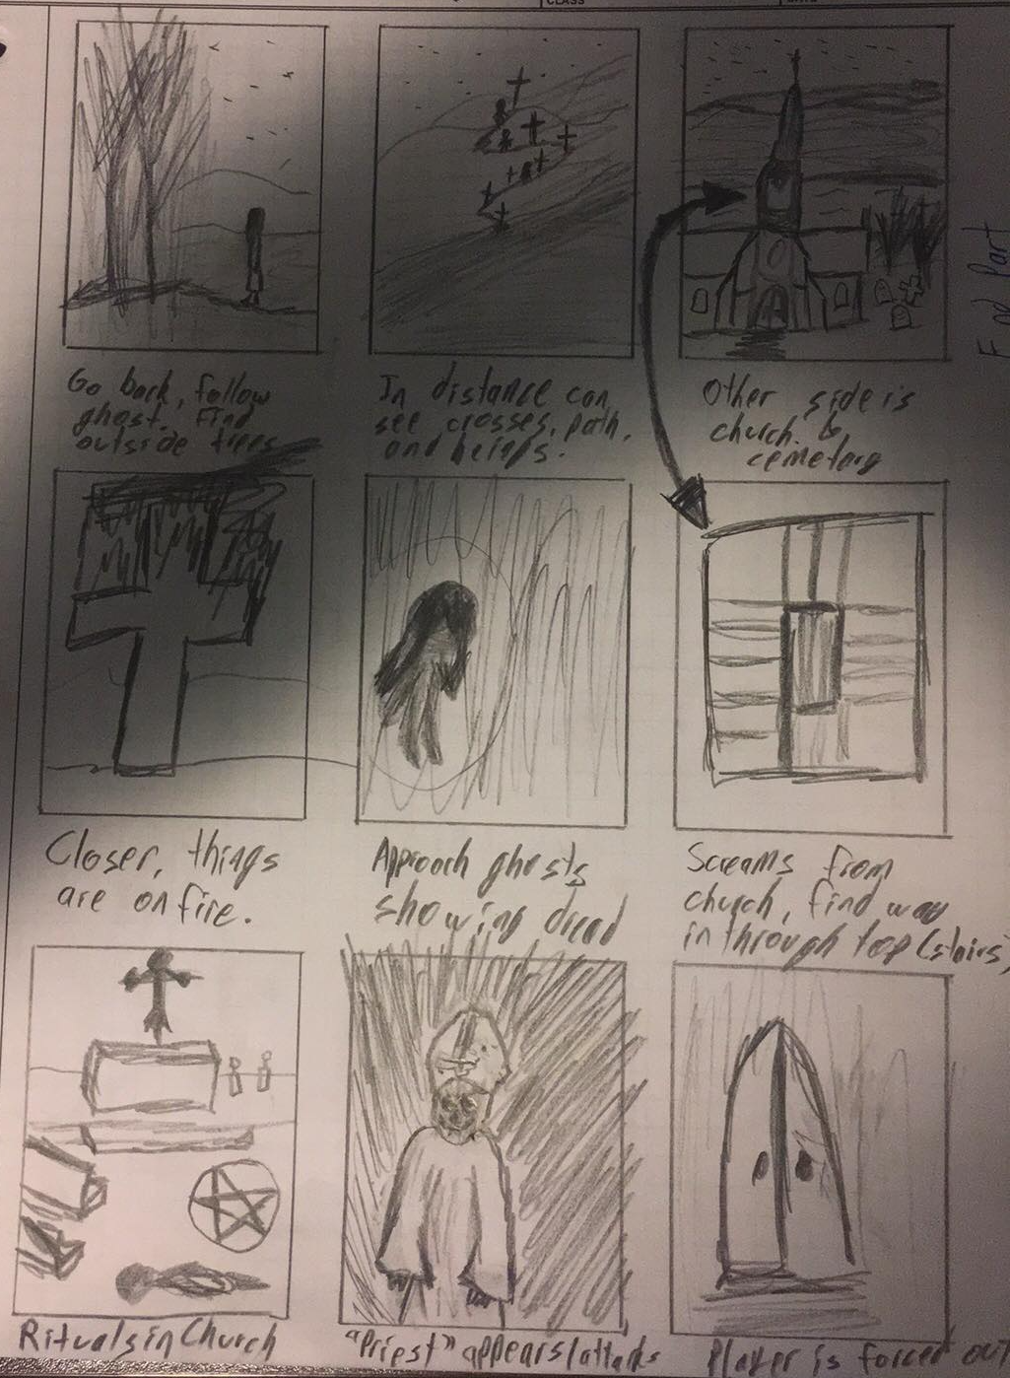
Story Boarding

Slide 6
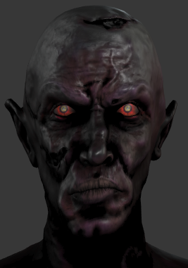
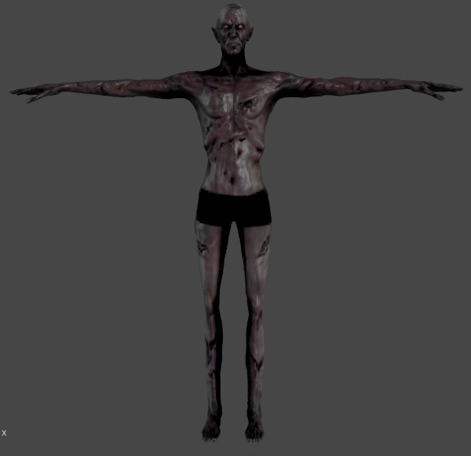
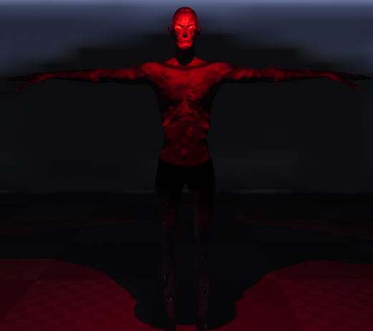
Characters: Main Demon

Slide 7
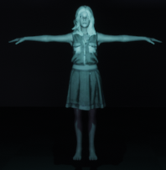
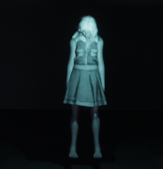
Characters: Main Ghost

Slide 8
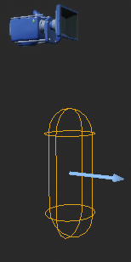
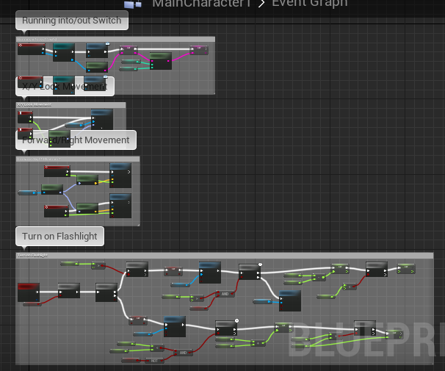
Characters: Player

Slide 9
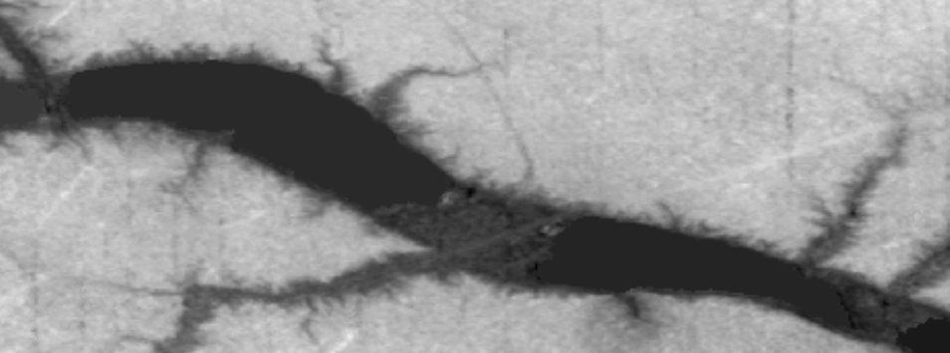
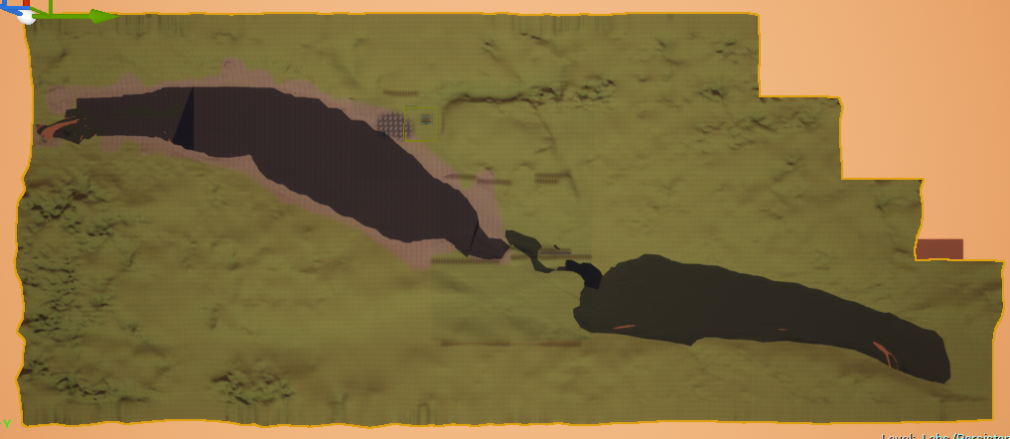
landscape
Valley Height Map
In-Game
Landscape

Slide 10
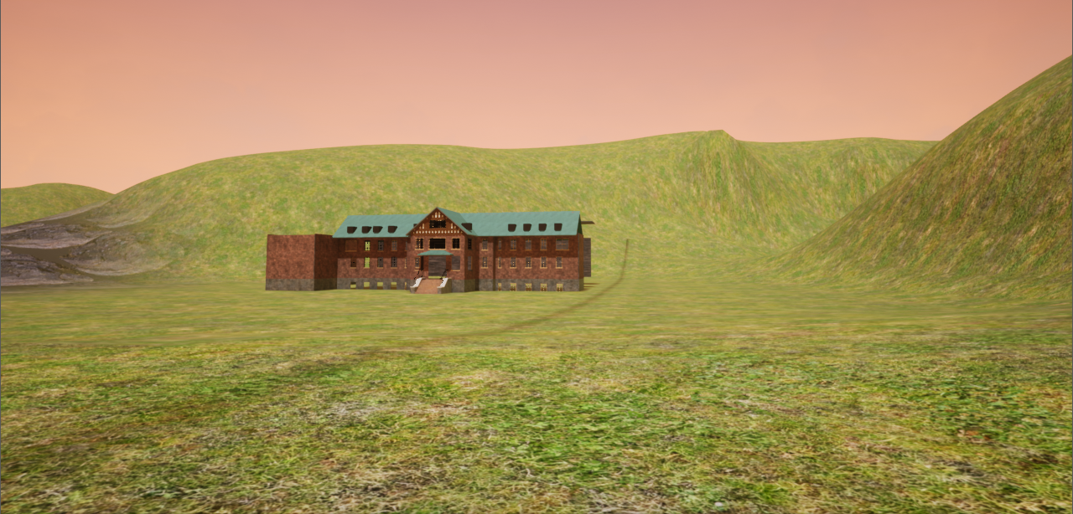
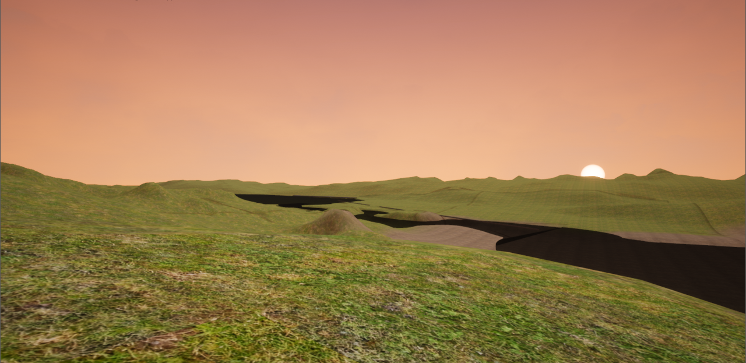
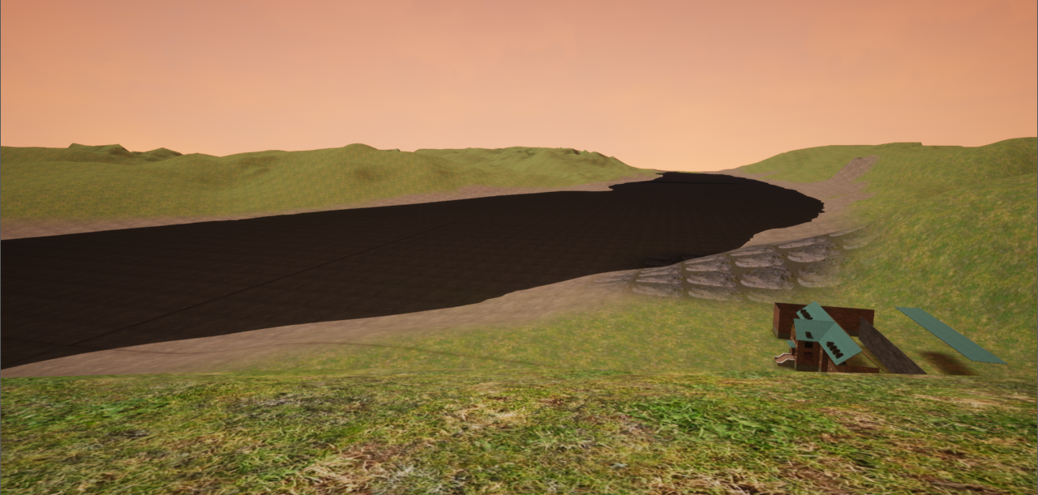
landscape

Slide 11
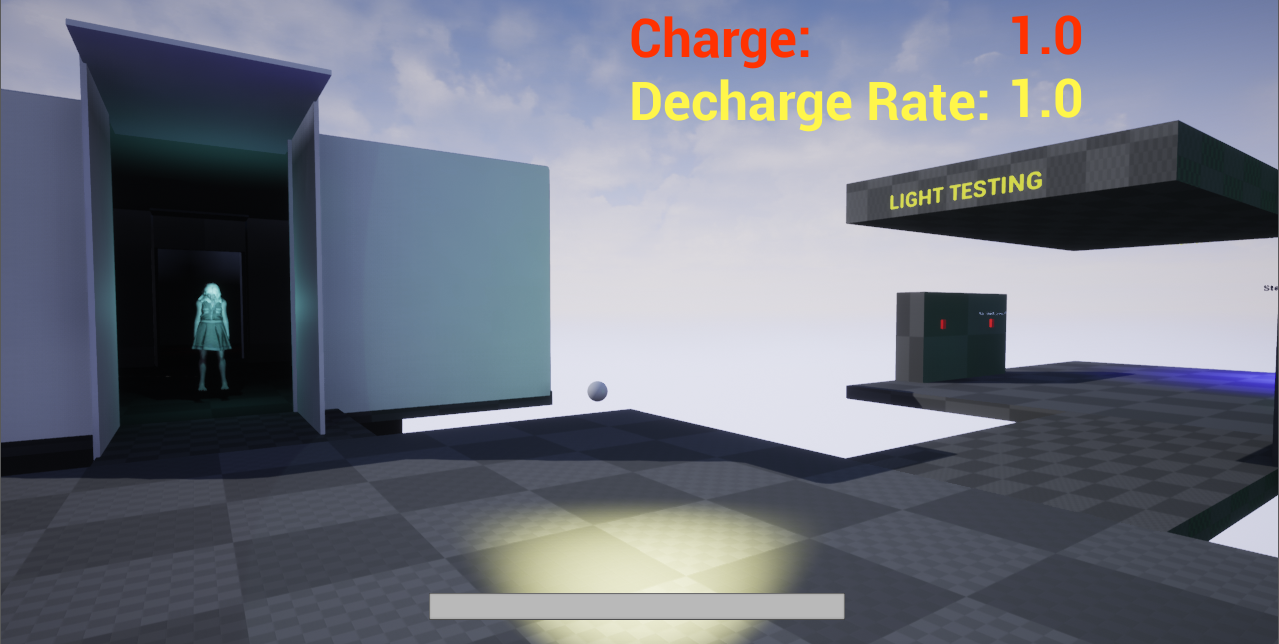
User interface (HUD)
Basic HUD with Flashlight Charge & Decharge Rate

Slide 12
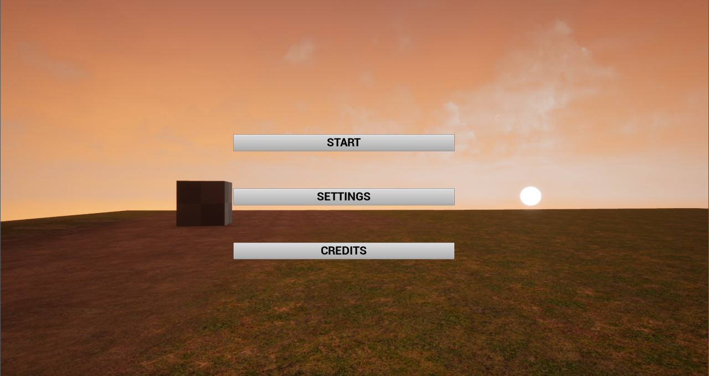
Main Menu

Slide 13
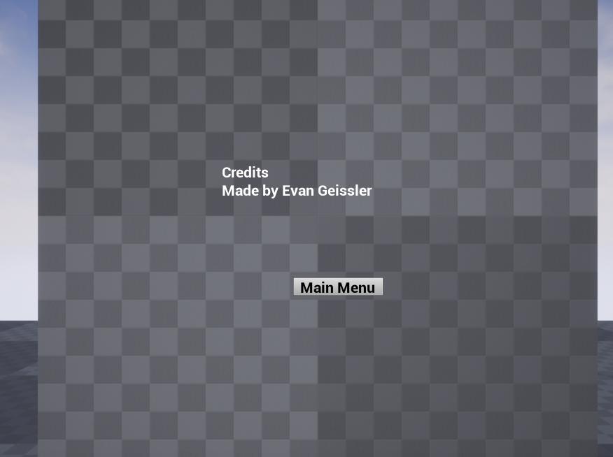
Credits

Slide 14
Testing
Types of Testing
Things to Test
Alpha Testing Utilizing:
Friends, peers, family, etc.
Myself
Character Movement
Does it feel natural?
Landscape
Does player get stuck?
Can player leave map?
NPCs
Do NPCs look right?
Are they proper size?
Create test level
Used for quick tests

